Slide 1
BAY RUNNER CHARTERS
2027 Charter Season Plan
Working draft for Pete Andersen, Chesapeake Charter Connection
$48,000
3 to 4
2
Net target after the broker cut
Charters per week, June to August
October fall rockfish windows held

Slide 2
Goals for the Season
1
Fill the slate
Book June through August to roughly $48,000 net after Pete's 15 percent cut.
2
Protect the crew
Three to four trips a week without flipping Tommy and the boat between commercial and charter all day.
3
Hold the fall
Block two October rockfish windows in advance. Two requests got turned away last year, money left on the table.
4
Hold the family
One weekend a month with no bookings. Quality days over volume, protect the reputation.

Slide 3
Confirmed and Held Bookings
Pricing 2027: Half day $675 | Full day $1,150 | Deposit 30 percent to hold | Booked through Pete Andersen, 15 percent broker cut
August 14 is an internal family hold, no charter. Rate card maintained in the season deck; deposits tracked in the household budget.

Slide 4
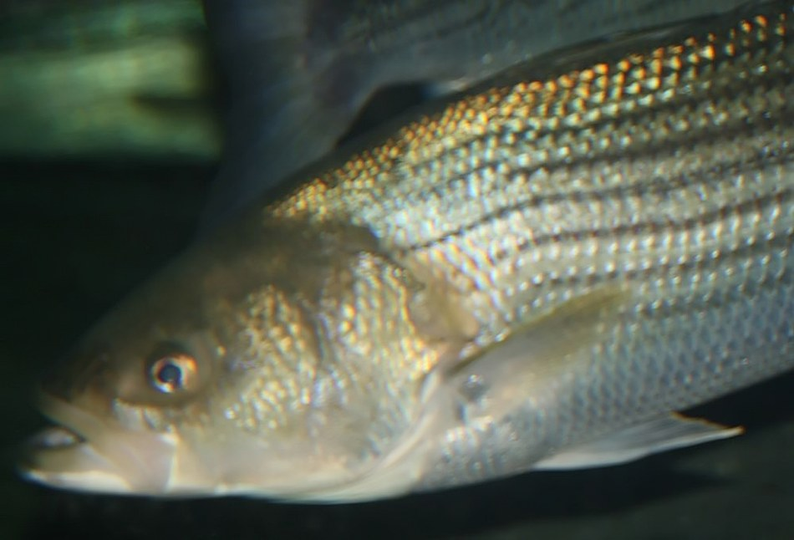
What We Target, and When
June trolls and live lines for rockfish. Late summer is fast bluefish for the kids. October is fat rockfish on the structure, the best eating fish of the season.

Slide 5
Calendar Risks and Next Steps
Watch the calendar
Next steps
Keep mornings open in late July, heat and low oxygen move the fish.
Do not book against DNR pot inspection prep before April 15.
Pace charter and commercial days to manage the back, use the puller.
Confirm the fall rockfish windows with Pete early.
Pete sends the June and July referral list.
Confirm deposits and update the booking workbook.
Lock the two October fall windows by November.
Review the certificate of insurance with Tidewater Marine.

